Slide 1
Case Study on
Multi-User Complaint Management System
Harikesh C

Slide 2
Introduction
In today’s fast-paced organizations and educational institutions, managing complaints efficiently is essential for maintaining transparency and trust.
CompSolveHub is a multi-user complaint management system designed to simplify the process of raising, tracking, and resolving issues through a centralized platform.
The application allows users to submit complaints and monitor their status in real time, while administrators can manage, update, and resolve issues effectively. With role-based access, email notifications, and an intuitive user interface
CompSolveHub ensures faster resolution, improved accountability, and a seamless communication flow between users and administrators.

Slide 3
Abstract
CompSolveHub is a web-based multi-user complaint management system developed to streamline the process of complaint registration, tracking, and resolution.
The system provides a centralized platform where users can raise complaints and monitor their status, while administrators efficiently manage and resolve issues through a dedicated dashboard.
Built using Spring Boot and a responsive user interface, the application ensures secure role-based access, real-time status updates, and automated email notifications. By improving transparency, accountability, and communication, CompSolveHub enhances organizational efficiency and delivers a structured approach to complaint handling.

Slide 4
What we are going to build: Client Requirement
A web-based complaint management system accessible to multiple users.
Facility for users to raise complaints with relevant details.
User registration and login system with role-based access (Admin & User).
Ability for users to track complaint status in real time.
An admin dashboard to view, manage, and update complaints.
Status management (Open, In Progress, Resolved) for complaints.
Automated email notifications to users when complaint status changes.

Slide 5
What we are going to build: Some technical terms.
A Spring Boot–based web application following the MVC architecture.
RESTful controllers to handle user and admin operations.
Role-based authentication and authorization (Admin & User).
MySQL relational database for secure and structured data storage.
Bootstrap-powered responsive UI for cross-device compatibility.
Email service integration (SMTP) for automated status notifications.
CRUD operations for complaint and user management.

Slide 6
What are the technologies and tools we are going use ?
Framework: Spring Boot Java Framework
Front-end : HTML5, CSS3, JS , Bootstrap
Programming Language: Java 8+
Build Tool: Maven
IDE: Spring Tool Suite (STS)
Web Server: Apache Tomcat
Spring Modules: Spring Core, Spring Security (JWT), Spring Data JPA (Hibernat
Database: MySQL Database

Slide 7
System Requirements
SOFTWARE REQUIREMENTS :
Back End: Spring Boot, Spring Data JPA (Hibernate)
Database Server: MySQL Server 8.0 CE
Web Server: Apache Tomcat
IDE: Spring Tool Suite (STS)
Browser: Any web-browser
Testing Tool: Junit(optional)

Slide 8
Project Module
Admin Module
User Module
Complaint Management Module
Email Notification Module

Slide 9
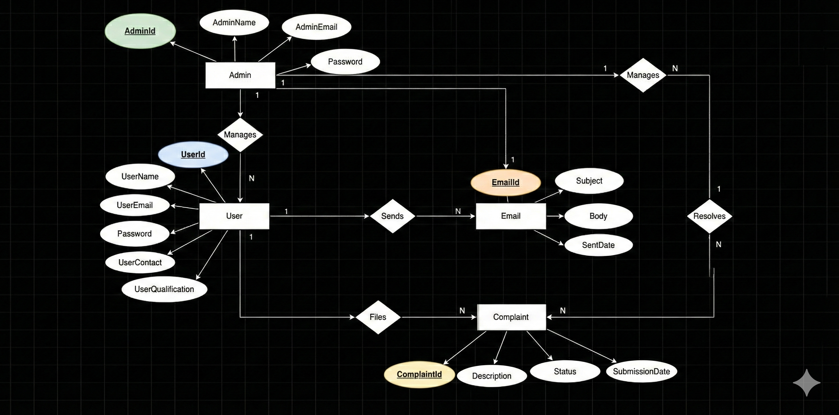
ER DIAGRAM

Slide 10
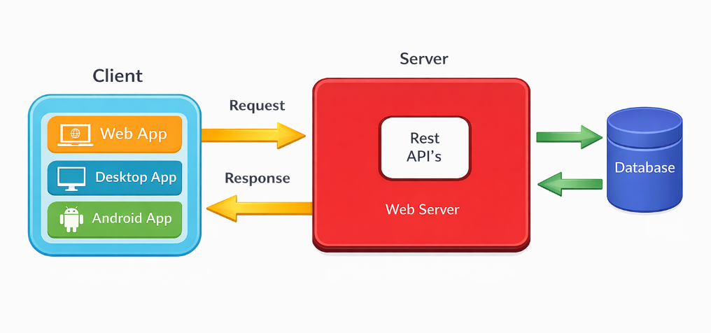
Client – Server Architecture

Slide 11
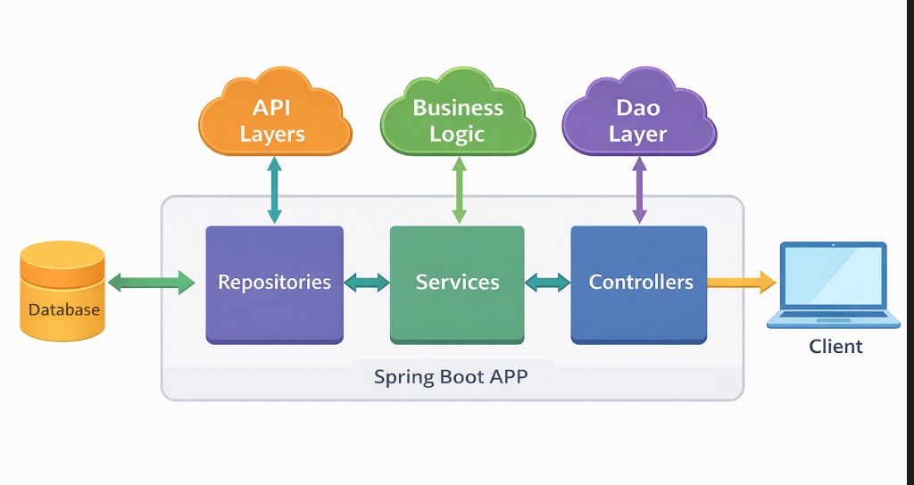
Architecture of Web App

Slide 12
ADMIN MODULE
In the Admin Module, the admin can access the system after successful login. The admin is responsible for managing the overall complaint handling process. Admin details are stored and managed through backend services.
The Admin module allows the admin to perform CRUD operations using REST APIs. Admin details can be saved using POST Mapping, retrieved using GET Mapping, updated using PUT Mapping, and deleted using DELETE Mapping.
The Admin module contains methods such as Save Admin, View All Complaints, Update Complaint Status, and Delete Complaint to ensure efficient management.
The Admin has the authority to view all user complaints, update their status (Open, In Progress, Resolved), and monitor complaint resolution.
After successful implementation of the Admin Module, child modules such as the User Module and Complaint Management Module are integrated under admin supervision.

Slide 13
USER MODULE
In the User Module, users can access the application after successful registration and login. This module allows users to interact with the system by submitting and tracking their complaints.
The User module allows users to register and log in to the application securely. User details are stored and managed through backend services.
Users can raise new complaints by submitting complaint details using POST Mapping. They can also view their submitted complaints using GET Mapping.
Users can track the status of complaints (Open, In Progress, Resolved) in real time through the user dashboard.
The User module contains methods such as Register User, Login User, Create Complaint, View Complaints, and Track Complaint Status to ensure smooth user interaction with the system.

Slide 14
Http Request Methods
HTTP defines a set of request methods to indicate the desired action to be performed for a given resource.
GET | http://localhost:8080/admin/complaints | Returns the list of all complaints
GET | http://localhost:8080/admin/complaints/AC_issue | Returns the list of complaints raised by a specific user
POST | http://localhost:8080/user/create-complaint | Creates a new complaint
PUT | http://localhost:8080/admin/update-status/1 | Updates the status of a complain by complaint ID
DELETE | http://localhost:8080/user/delete-complaint/3 | Deletes a complaint by complaint ID

Slide 15
COMPLAINT MANAGEMENT MODULE
The Complaint Management Module is responsible for handling the complete lifecycle of complaints within the system.
It allows users to create new complaints by submitting details such as title, description, and category using POST Mapping.
The module enables users to view their submitted complaints along with current status using GET Mapping.
Admin users can view all complaints raised by different users through the admin dashboard.
Admins can update the complaint status (Open, In Progress, Resolved) using PUT Mapping to track resolution progress.

Slide 16
EMAIL NOTIFICATION MODULE
The Email Notification Module is used to provide automated email communication between the system and users.
This module sends an email notification to users whenever the status of their complaint is updated by the admin.
Email alerts are triggered when a complaint is resolved or moved to a different status such as Open or In Progress.
The module is implemented using SMTP (JavaMailSender) for sending emails securely.

Slide 17
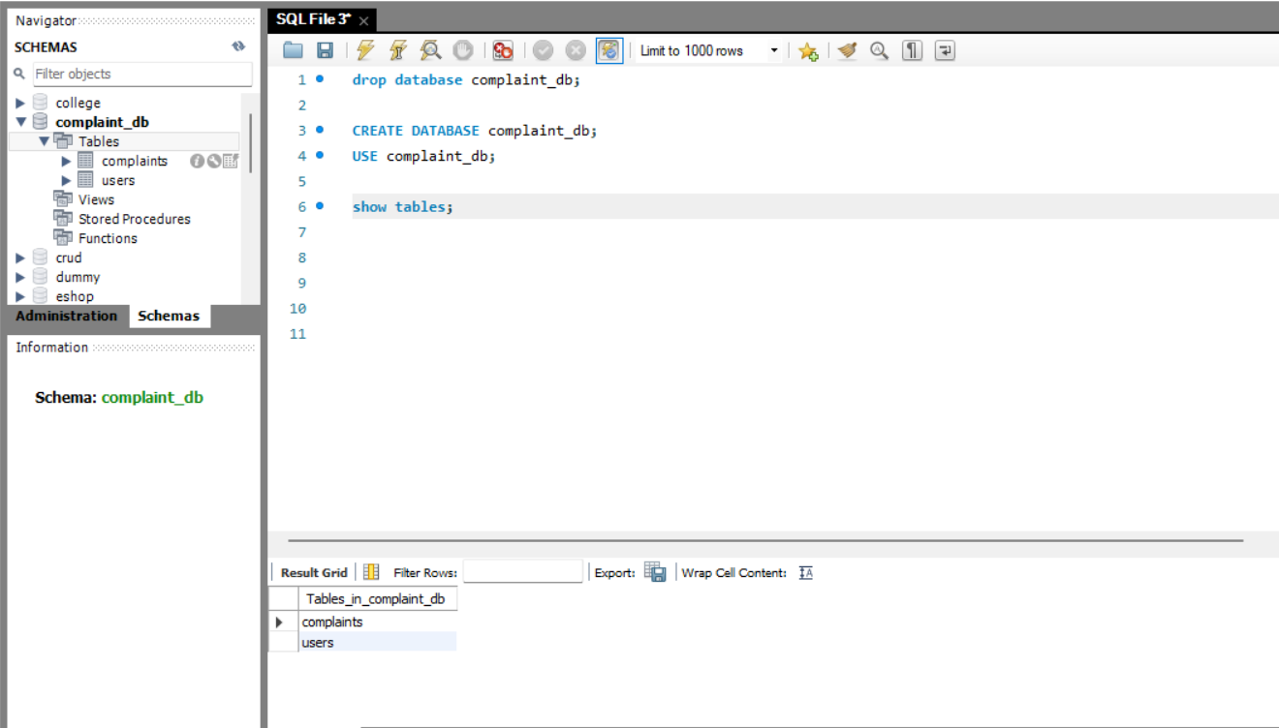
Tables for the database

Slide 18
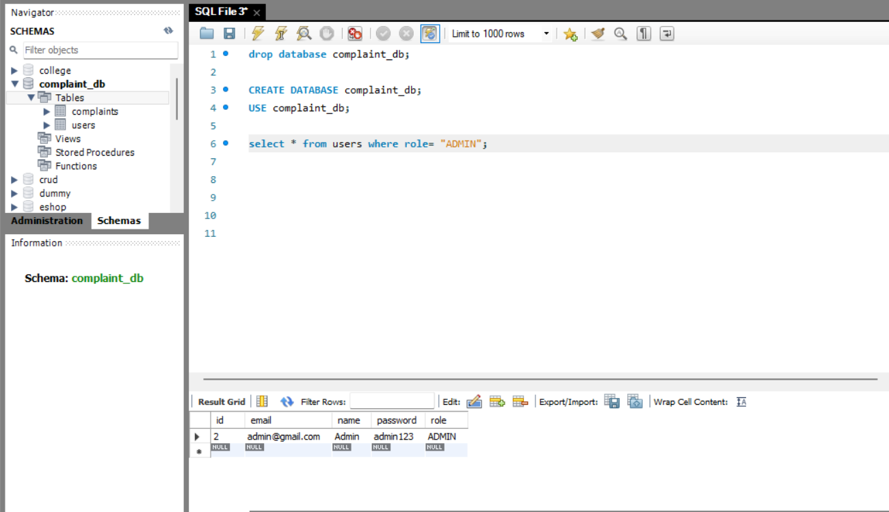
Admin Database

Slide 19
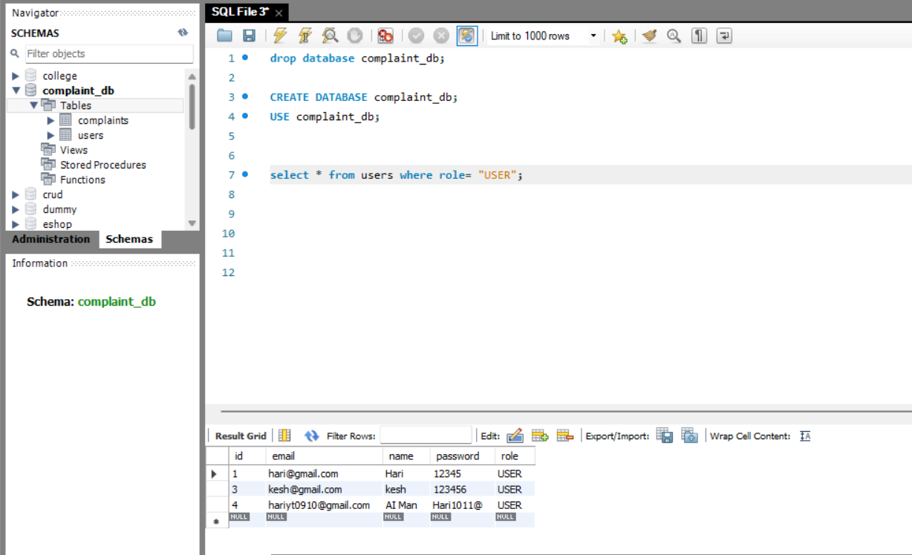
Student Database

Slide 20
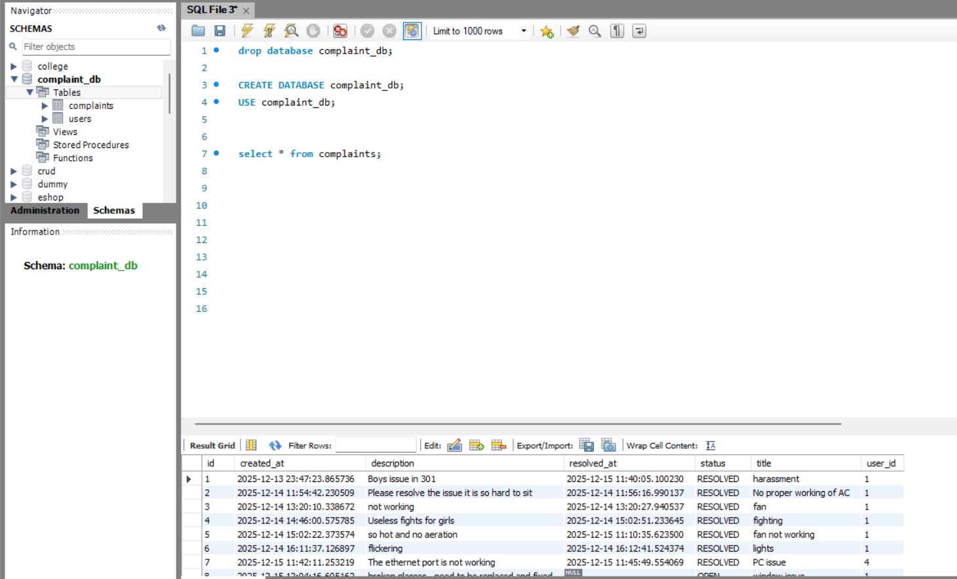
Complaint Database

Slide 21
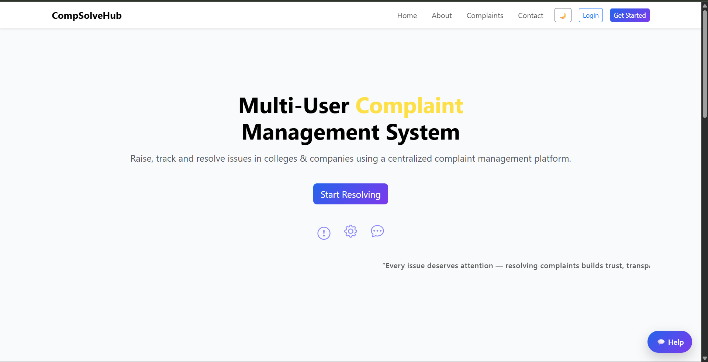
ScreenShots of the Capstone Project

Slide 22
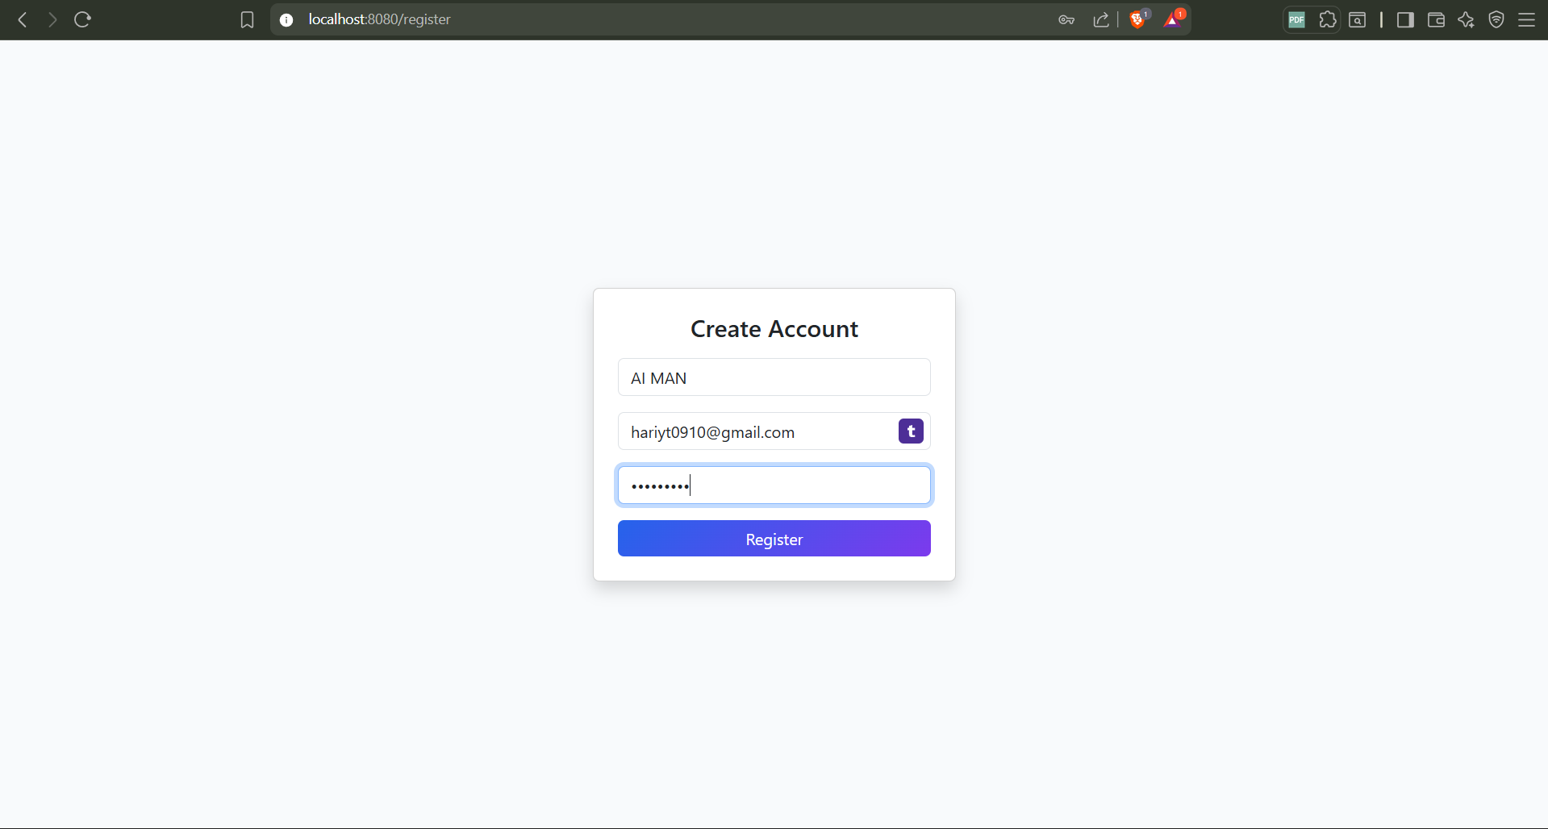
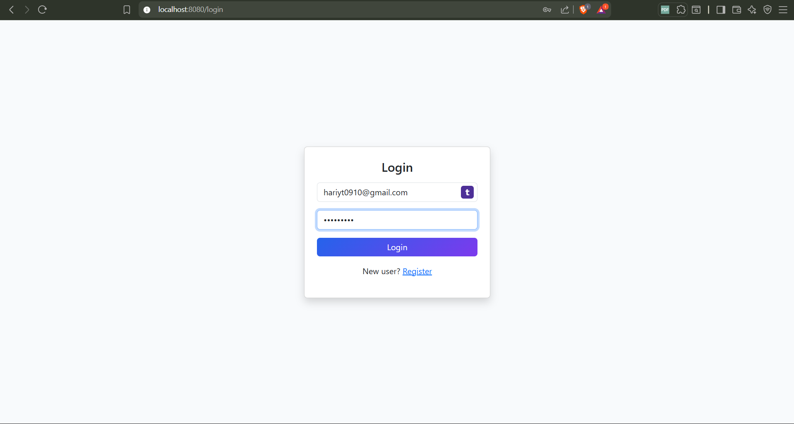
Create Account Page and Login Page

Slide 23
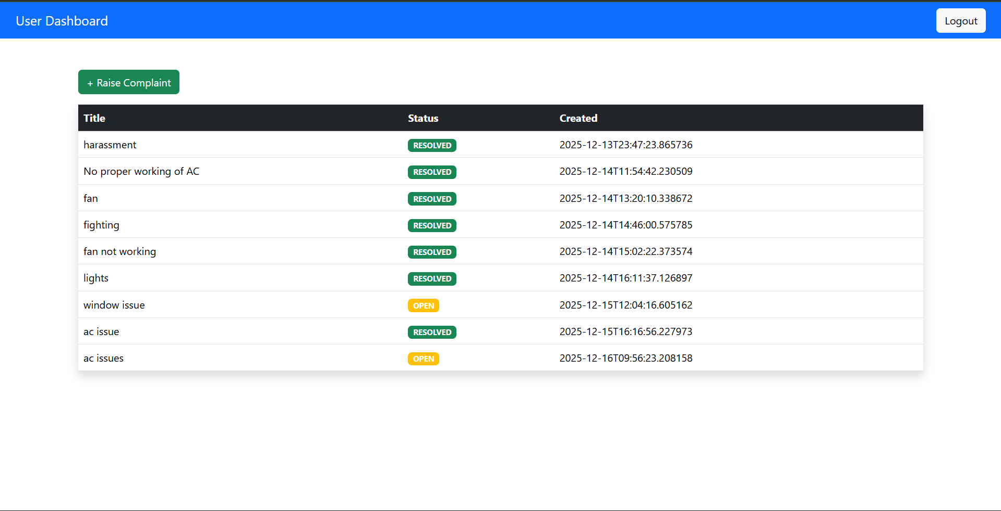
Admin Dashboard

Slide 24
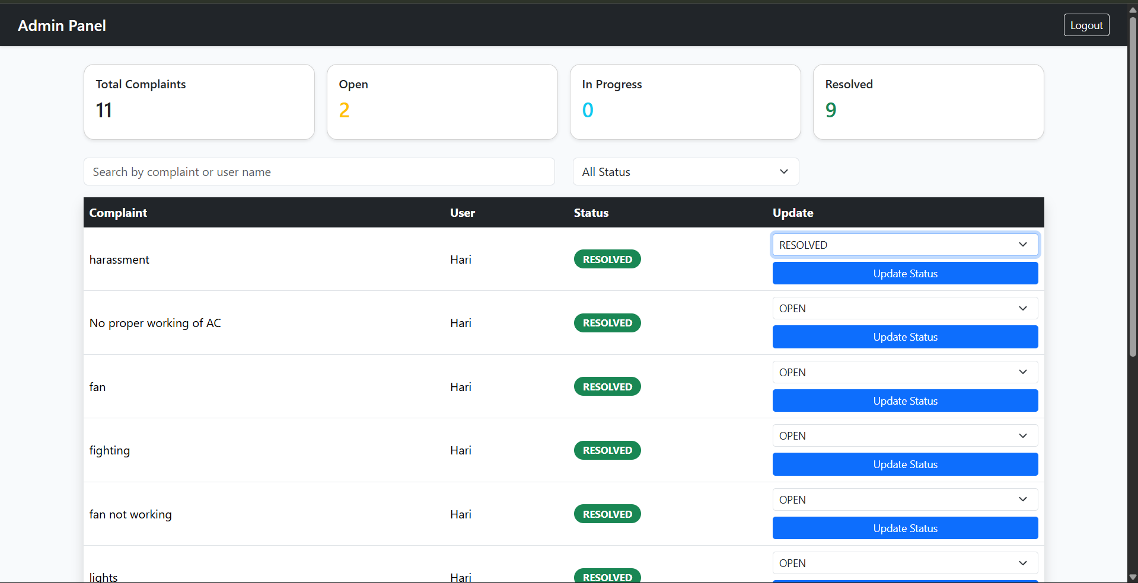
User Dashboard

Slide 25
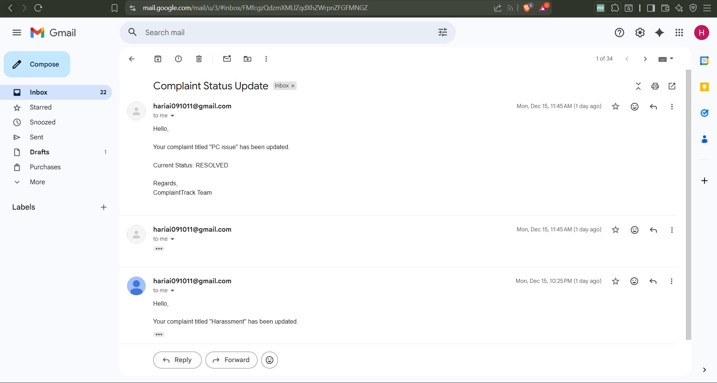
Email Status

Slide 26
GOOGLE DRIVE LINK OF DEMO VIDEO
https://drive.google.com/drive/folders/1Wt70r9VV-8YDuc9eatOABoHjjyvSBWcx?usp=sharing

